Slide 1


Noida Institute of Engineering and Technology, Greater Noida
UNIT 3
Dynamic Programming
Data Structure and Algorithms-II
CCSE0301
Dr. Amba Mishra
Associate Professor
IT Deptt.
B.Tech 3rd Sem

Slide 2
Brief Introduction
My self Dr. Amba Mishra, currently serving as Associate Professor in IT Department of Noida Institute of Engineering & Technology, Greater Noida, Uttar Pradesh.
I have 17yrs of Teaching and 1Yr. Of Industry experience.
I did my Ph.D from NIU Greater Noida and M.Tech from CDAC Noida(GGSIP University, Delhi).
My research area includes Information security and Artificial Intelligence.

Slide 3
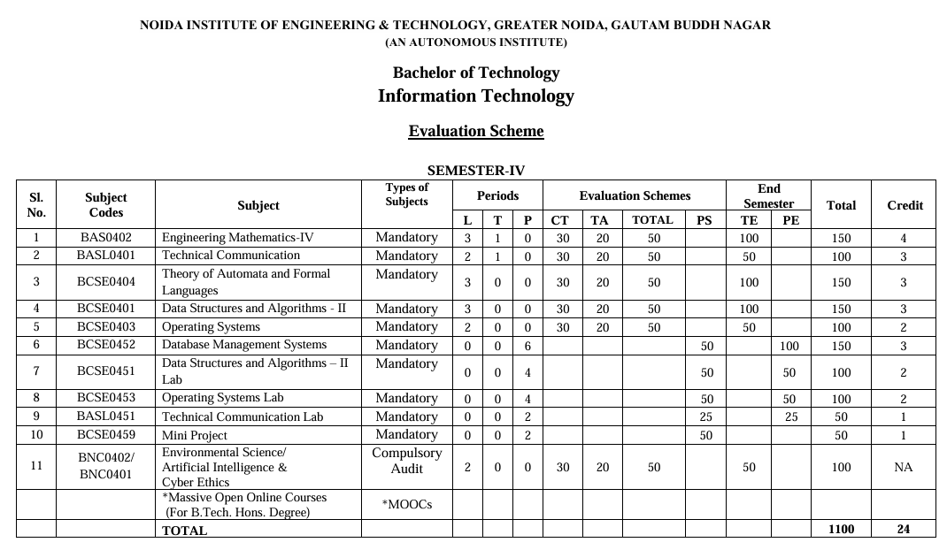
Evaluation scheme

Slide 4
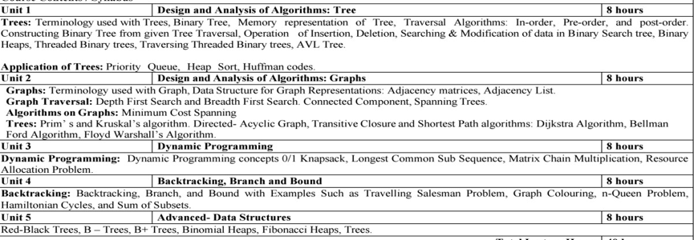
Subject Syllabus

Slide 5
Branch wise Applications
COMPUTER SCIENCE AND INFORMATION TECHNOLOGY
OPTIMIZATION: Enhancing performance of software and hardware through efficient algorithms
DATABASE MANAGEMENT: Use data structure like B-tree and hashing for efficient data storage and retrieval.
NETWORKING: Algorithms for routing, data compression and error detection.
OPERATING SYSTEM: Implementation of scheduling algorithm, memory management and file management.

Slide 6
Course Objective
The objective of the course is to learn the basic concepts of algorithm analysis, along with the implementation of non-linear data structures.

Slide 7
Course Outcomes
Course Outcomes (CO) |  | Bloom’s Knowledge Level(KL)
CO1 | Apply tree structures to solve specific problems using various tree operations and algorithms. | K3
CO2 | Analyse the graph data structure and evaluate the efficiency of its operations for problem solving. | K4
CO3 | Evaluate dynamic programming solutions for efficient problem-solving across diverse contexts. | K4
CO4 | Apply efficient backtracking and branch –and –bound techniques across diverse problem-solving scenarios. | K3
CO5 | Understand principles of advanced data structures, including their implementation and applications. | K2

Slide 8
Program Outcomes (POs)
Engineering Knowledge
Problem Analysis
Design/Development of Solutions
Conduct Investigations of Complex Problems
Engineering Tool Usage
The Engineer and The World
Ethics
Individual and Collaborative Team work
Communication
Project Management and Finance
Life-Long Learning

Slide 9
COs and POs Mapping
Sr. No |  | PO 1 | PO 2 | PO 3 | PO 4 | PO 5 | PO 6 | PO 7 | PO 8 | PO 9 | PO1 0 | PO1 1
1 | CO 1 | 3 | 3 | 2 | 1 | 1 | 2 | 1 | 1 | 2 | 1 | 3
2 | CO 2 | 3 | 3 | 2 | 1 | 1 | 2 | 1 | 1 | 2 | 1 | 3
3 | CO 3 | 3 | 3 | 2 | 2 | 2 | 2 | 1 | 1 | 2 | 2 | 3
4 | CO 4 | 3 | 3 | 3 | 2 | 2 | 2 | 1 | 1 | 2 | 1 | -3
5 | CO 5 | 3 | 3 | 3 | 2 | 2 | 2 | 1 | 1 | 2 | 2 | 3
Average |  | 3 | 3 | 2.4 | 1.6 | 1.6 | 2 | 1 | 1 | 2 | 1.4

Slide 10
Program Specific Outcomes (PSOs)
S.NO. | Program Specific Outcomes | PSO Description
1 | PSO1 | Work as a software engineer in different dimensions of information technology to provide solutions to real-world and industrial problems in an eco-friendly manner
2 | PSO2 | Apply knowledge of core subjects with multi-disciplinary and modern computing techniques to solve complex IT problems.
3 | PSO3 | Establish a successful and innovative career by practicing lifelong learning and communicating in a team or as an individual to manage projects with ethical concerns.

Slide 11
COs and PSOs Mapping
S.No | PSO 1 | PSO 2 | PSO 3
CO 1 | 2 | 1 | 2
CO 2 | 2 | 1 | 2
CO 3 | 2 | 1 | 2
CO 4 | 2 | 1 | 2
CO 5 | 2 | 1 | 2
Average | 2 | 1 | 2

Slide 12
Program Educational Objectives (PEOs)
PEO1: To apply sound knowledge combining technical expertise, and problem-solving skills to fulfill the needs of the IT industry and stay updated with the latest emerging trends.
PEO2: To provide sustainable solutions for real-life problems by designing innovative and interdisciplinary systems using the latest digital technologies for serving academia, industry, and society.
PEO3: To reflect professional attitude, social ethics, communication, teamwork, and leadership skills in research and product development to face global challenges.
PEO4: To pursue higher studies and develop their career successfully in the software industry and R&D sectors with a lifelong learning frame of mind.

Slide 13
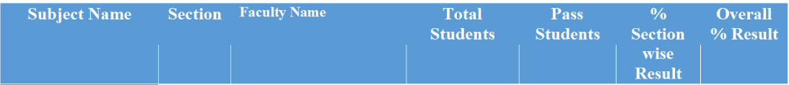
Result Analysis 2024-25

Slide 14
End Semester Question Paper Templates
B TECH
(SEM-IV) THEORY EXAMINATION 20__-20__
COMPILER DESIGN
Time: 3 Hours Total Marks: 100
Note: 1. Attempt all Sections. If require any missing data; then choose suitably.
SECTION A
Attempt all questions in brief. 2 x 10 = 20
Q.No. | Question | Marks | CO
1 |  | 2
2 |  | 2
. |  | .
10 |  | 2

Slide 15
End Semester Question Paper Templates
SECTION B
2. Attempt any three of the following: 3 x 10 = 30
SECTION C
3. Attempt any one part of the following: 1 x 10 = 10
Q.No. | Question | Marks | CO
1 |  | 10
2 |  | 10
. |  | .
5 |  | 10
Q.No. | Question | Marks | CO
1 |  | 10
2 |  | 10

Slide 16
End Semester Question Paper Templates
4. Attempt any one part of the following: 1 x 10 = 10
5. Attempt any one part of the following: 1 x 10 = 10
6. Attempt any one part of the following: 1 x 10 = 10
Q.No. | Question | Marks | CO
1 |  | 10
2 |  | 10
Q.No. | Question | Marks | CO
1 |  | 10
2 |  | 10
Q.No. | Question | Marks | CO
1 |  | 10
2 |  | 10

Slide 17
Prequisite/ Recap
Understanding of basic data structures and algorithms.
How to design an algorithm.
Understanding of asymptotic notations.

Slide 18
Brief Introduction about the Subject with videos
Dynamic Programming is an algorithm design technique that can be used for solving the problem that can be solvable by making sequence of decision.
Used to find optimal solution.
Lec-17 Other Issues - Introduction to Dynamic Programming
Lecture -18 Dynamic Programming

Slide 19
Unit Content
Dynamic programming introduction
Key concepts
Advantages of DP
Disadvantages of DP
Applications of DP
0/1 knapsack problem
Longest common subsequence
Matrix chain multiplication
Resource allocation problem

Slide 20
Unit Objective
Understanding the concept of Dynamic programming.
How it can be used to get an optimal solution.

Slide 21
Introduction to Dynamic Programming
Technique by Richard Bellman, 1950s
Breaks problem → overlapping subproblems
Stores results to avoid recomputation
Two properties needed:
  Optimal Substructure
  Overlapping Subproblems
Approach:* Top-Down = Memoization, Bottom-Up = Tabulation

Slide 22
Key Concepts of DP
State: Parameters defining subproblem dp[i][w]
Transition/Recurrence: Relation between states
Base Case: Smallest subproblem
Memoization: Cache recursive results
Tabulation: Fill table iteratively

Slide 23
Advantages of DP
Time Efficient: Exponential → Polynomial. Ex: Fib O(2ⁿ) → O(n)
Guarantees Optimality for problems with optimal substructure
Solves Complex Problems unsolvable by greedy
Reusable Subsolutions

Slide 24
Disadvantages of DP
High Space Complexity: O(n²) tables common
Hard to Formulate: Defining state/recurrence is tricky
Overkill for Simple Problems: Greedy may be better
Not Always Intuitive: Debugging tables is hard

Slide 25
Applications of DP
Optimization: Knapsack, MCM, Resource Allocation
Strings: LCS, Edit Distance, Palindromes
Graphs: Floyd-Warshall, Bellman-Ford
Bioinformatics: Sequence Alignment
Economics: Investment, Production Planning

Slide 26
0/1 Knapsack Problem
Consider a thief gets into a home to rob and he carries a knapsack. There are fixed number of items in the home — each with its own weight and value — Jewelry, with less weight and highest value vs tables, with less value but a lot heavy.
To add fuel to the fire, the thief has an old knapsack which has limited capacity.
Obviously, he can’t split the table into half or jewelry into 3/4ths. He either takes it or leaves it.

Slide 27
0/1 Knapsack Problem
Dynamic-Programming Approach
Let i be the highest-numbered item in an optimal solution S for W dollars. Then S' = S - {i} is an optimal solution for W - w_{i} dollars and the value to the solution S is V_{i} plus the value of the sub-problem.
We can express this fact in the following formula: define c[i, w] to be the solution for items 1,2, … , i and the max_{i}mum weight w.
The algorithm takes the following inputs
The max_{i}mum weight W
The number of items n
The two sequences v = <v₁, v₂, …, v_{n}> and w = <w₁, w₂, …, w_{n}>

Slide 28
0/1 Knapsack Problem
Dynamic-0-1-knapsack (v, w, n, W)
for w = 0 to W do
c[0, w] = 0
for i = 1 to n do
c[i, 0] = 0
for w = 1 to W do
if w_{i} ≤ w then
if p_{i} + c[i-1, w-w_{i}] > c[i-1, w]
c[i, w] = p_{i} + c[i-1, w-w_{i}]
else c[i, w] = c[i-1, w]
else
c[i, w] = c[i-1, w]
return c

Slide 29
0/1 Knapsack Problem
 | Obj 1 | Obj 2 | Obj 3 | Obj4
Wi | 2 | 3 | 4 | 5
Pi | 3 | 4 | 5 | 6
M = 5
i\wi | 0 | 1 | 2 | 3 | 4 | 5
0 | 0 | 0 | 0 | 0 | 0 | 0
1 | 0 | 0 | 3 | 3 | 3 | 3
2 | 0 | 0 | 3 | 4 | 4 | 7
3 | 0 | 0 | 3 | 4 | 5 | 7
4 | 0 | 0 | 3 | 4 | 5 | 7
Pi | Wi
3 | 2
4 | 3
5 | 4
6 | 5

Slide 30
0/1 Knapsack Problem
The set of items to take can be deduced from the table, starting at c[n, w] and tracing backwards where the optimal values came from.
If c[i, w] = c[i-1, w], then item i is not part of the solution, and we continue tracing with c[i-1, w]. Otherwise, item i is part of the solution, and we continue tracing with c[i-1, w-W].
Analysis
This algorithm takes θ(n, w) times as table c has (n + 1).(w + 1) entries, where each entry requires θ(1) time to compute.

Slide 31
0/1 Knapsack Problem
Steps
To calculate the maximum value that we can obtain with item i, we first need to compare the weight of item i with the knapsack’s weight capacity.
Obviously, if item i weighs more than what the knapsack can hold, we can’t include it, so it does not make sense to perform the calculation.
In that case, the solution to this problem is simply the maximum value that we can obtain without item i (i.e. the value in the row above, at the same column).

Slide 32
0/1 Knapsack Problem
However, suppose that item i weighs less than the knapsack’s capacity.
We thus have the option to include it, if it potentially increases the maximum obtainable value.
The maximum obtainable value by including item i is thus = the value of item i itself + the maximum value that can be obtained with the remaining capacity of the knapsack.
We obviously want to make full use of the capacity of our knapsack, and not let any remaining capacity go to waste.
Therefore, at row i and column j (which represents the maximum value we can obtain there), we would pick either the maximum value that we can obtain without item i, or the maximum value that we can obtain with item i, whichever is larger.

Slide 33
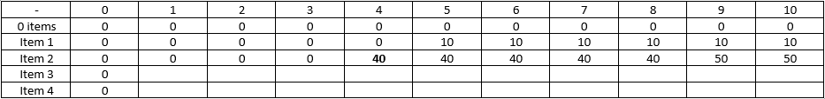
0/1 Knapsack Problem
For Example
At row 3 (item 2), and column 5 (knapsack capacity of 4), we can choose to either include item 2 (which weighs 4 units) or not.
If we choose not to include it, the maximum value we can obtain is the same as if we only have item 1 to choose from (which is found in the row above, i.e. 0).

Slide 34
0/1 Knapsack Problem
If we want to include item 2, the maximum value we can obtain with item 2 is the value of item 2 (40) + the maximum value we can obtain with the remaining capacity (which is 0, because the knapsack is completely full already).
At row 3 (item 2), and column 10 (knapsack capacity of 9), again, we can choose to either include item 2 or not.
If we choose not to, the maximum value we can obtain is the same as that in the row above at the same column, i.e. 10 (by including only item 1, which has a value of 10).

Slide 35
0/1 Knapsack Problem
If we include item 2, we have a remaining knapsack capacity of 9 - 4 = 5.
We can find out the maximum value that can be obtained with a capacity of 5 by looking at the row above, at column 5.
Thus, the maximum value we can obtain by including item 2 is 40 (the value of item 2) + 10 = 50.
We pick the larger of 50 vs 10, and so the maximum value we can obtain with items 1 and 2, with a knapsack capacity of 9, is 50.
Once the table has been populated, the final solution can be found at the last row in the last column, which represents the maximum value obtainable with all the items and the full capacity of the knapsack.
For more examples watch the following youtube link
https://www.youtube.com/watch?v=oTTzNMHM05I

Slide 36
0/1 Knapsack Problem
Daily Qquuiz
Which property is NOT required for DP to be applicable?
A. Optimal Substructure
B. Overlapping Subproblems
C. Greedy Choice Property
D. Both A and B are required
In 0/1 Knapsack, if wt[i] > W then:
A. dp[i][w] = dp[i-1][w]
B. dp[i][w] = 0
C. dp[i][w] = val[i]
D. Item must be included
0/1 Knapsack cannot be solved by greedy because:
A. It’s too slow
B. Local optimal ≠ Global optimal
C. No overlapping subproblems
D. It needs sorting

Slide 37
Longest Common Subsequence (LCS)
Substring – Group of characters in contiguous location.
Subsequence – Group of characters in non -contiguous location.
Example
String : ABCDEF
Substring – ABC
Subsequence – ACE
Application: DNA Matching, Matching of two version of softwares, Search engines, Plagiarism.

Slide 38
Longest Common Subsequence (LCS)
The longest common subsequence (LCS) is defined as the longest subsequence that is common to all the given sequences, provided that the elements of the subsequence are not required to occupy consecutive positions within the original sequences.
If S1 and S2 are the two given sequences then, Z is the common subsequence of S1 and S2 if Z is a subsequence of both S1 and S2. Furthermore, Z must be a strictly increasing sequence of the indices of both S1 and S2.
In a strictly increasing sequence, the indices of the elements chosen from the original sequences must be in ascending order in Z.

Slide 39
Longest Common Subsequence (LCS)
If S1={B,C,D,A,A,C,D} then, {A,D,B} cannot be a subsequence of S1 as the order of the elements is not the same (ie. not strictly increasing sequence).
Let us understand LCS with an example:
If S1 = {B,C,D,A,A,C,D}
S2 = {A,C, D,B,A,C}
Then, common subsequences are:
{B,C}{C,D,A,C}{D,A,C}{A,A,C}{A,C}{C,D}…
Among these subsequences, {C,D,A,C} is the longest common subsequence. We are going to find this longest common subsequence using dynamic programming.

Slide 40
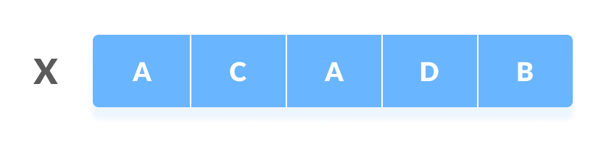
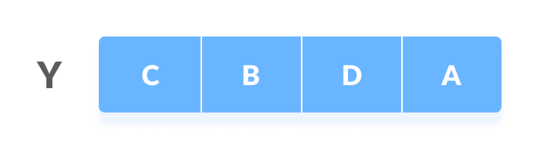
Longest Common Subsequence (LCS)
Using Dynamic Programming to find the LCS
Let us take two sequences:
The following steps are followed for finding the longest common subsequence.
Create a table of dimension n+1*m+1 where n and m are the lengths of X and Y respectively. The first row and the first column are filled with zeros.

Slide 41
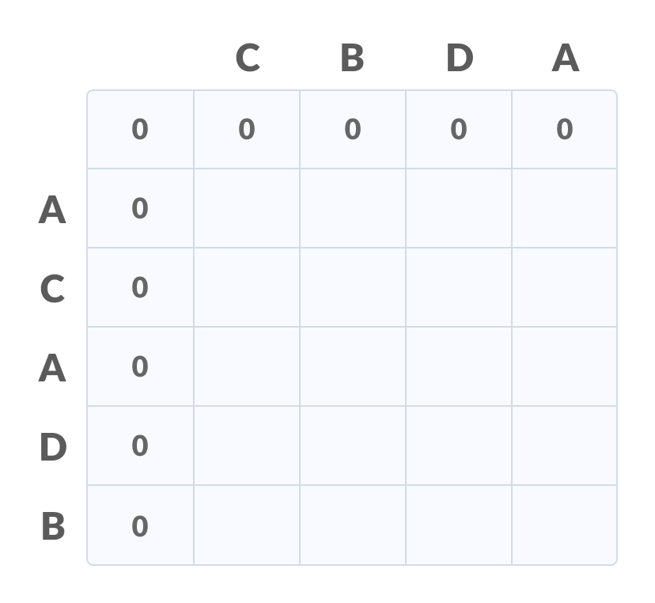
Longest Common Subsequence (LCS)
Fill each cell of the table using the following logic.
If the character corresponding to the current row and current column are matching, then fill the current cell by adding one to the diagonal element. Point an arrow to the diagonal cell.
Else take the maximum value from the previous column and previous row element for filling the current cell. Point an arrow to the cell with maximum value. If they are equal, point to any of them.

Slide 42
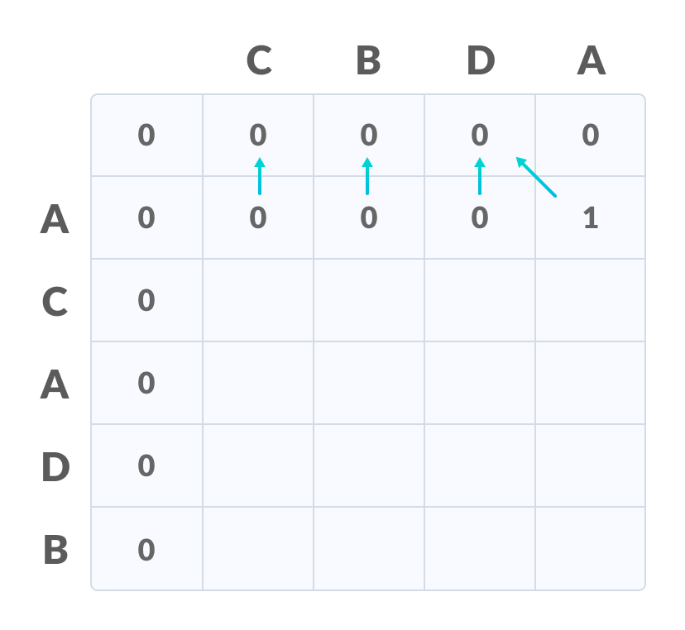
Longest Common Subsequence (LCS)
Step 2 is repeated until the table is filled.

Slide 43
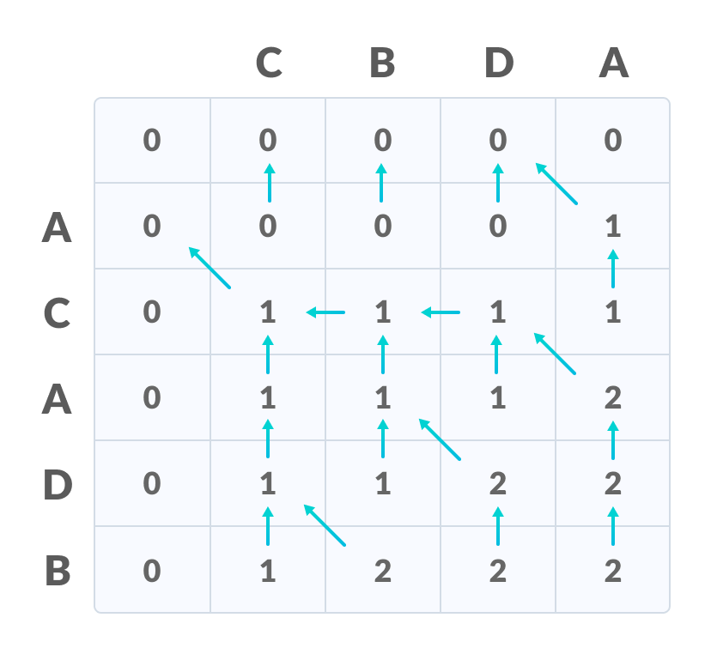
Longest Common Subsequence (LCS)
The value in the last row and the last column is the length of the longest common subsequence.

Slide 44
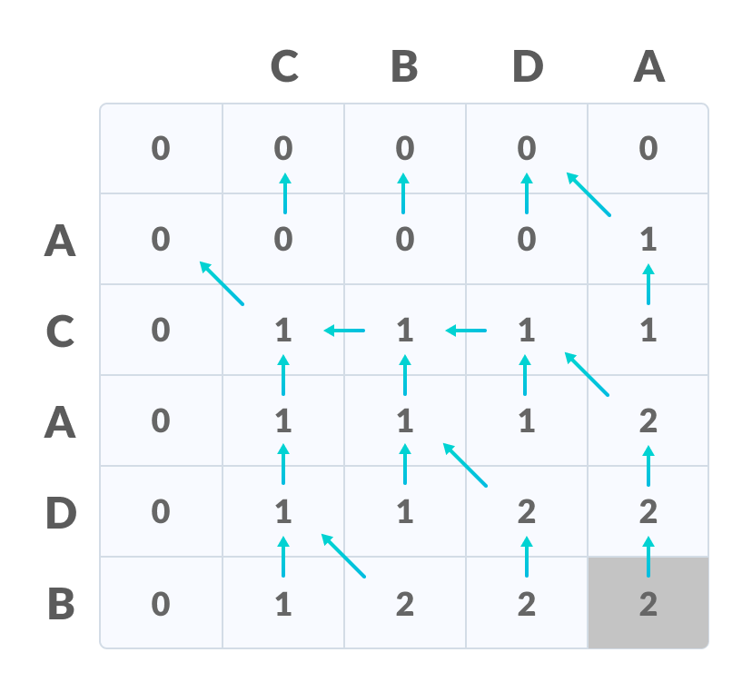
Longest Common Subsequence (LCS)
In order to find the longest common subsequence, start from the last element and follow the direction of the arrow. The elements corresponding to () symbol form the longest common subsequence.

Slide 45
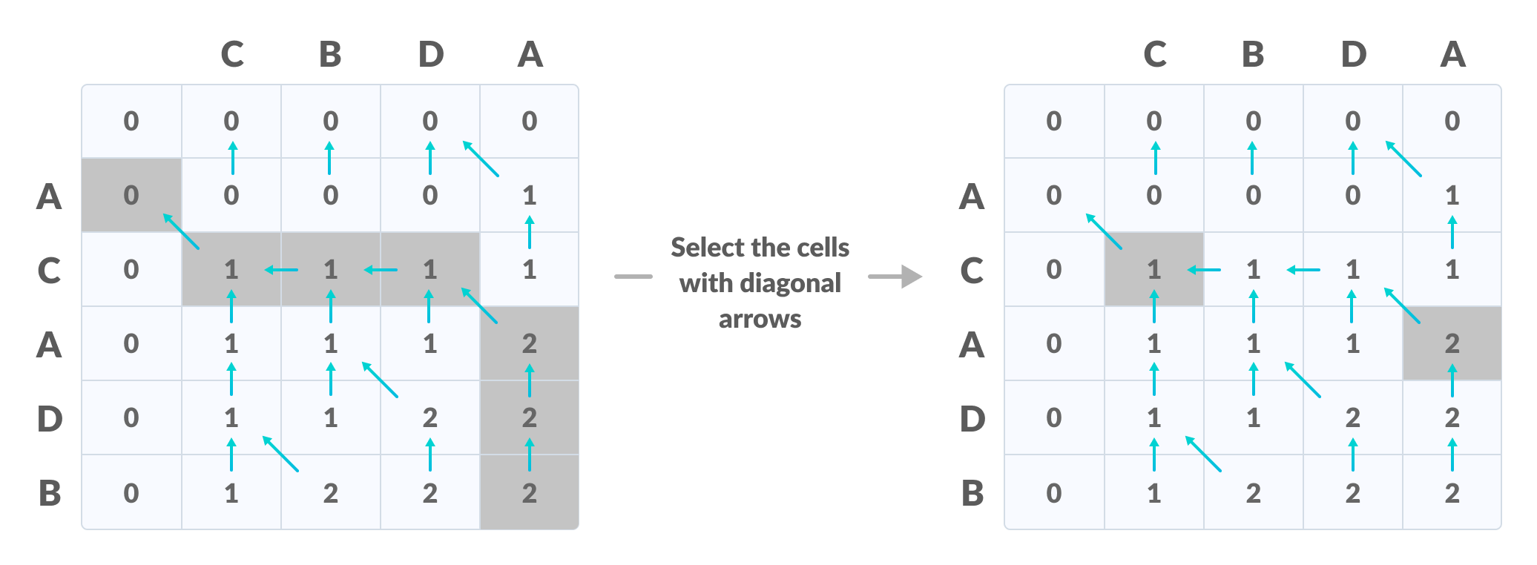
Longest Common Subsequence (LCS)
Thus, the longest common subsequence is C,A

Slide 46
Longest Common Subsequence (LCS)
How is a dynamic programming algorithm more efficient than the recursive algorithm while solving an LCS problem?
The method of dynamic programming reduces the number of function calls. It stores the result of each function call so that it can be used in future calls without the need for redundant calls.
In the above dynamic algorithm, the results obtained from each comparison between elements of X and the elements of Y are stored in a table so that they can be used in future computations.
So, the time taken by a dynamic approach is the time taken to fill the table (ie. O(mn)). Whereas, the recursion algorithm has the complexity of 2^{max(m,n)}

Slide 47
Longest Common Subsequence (LCS)
Longest Common Subsequence Algorithm
X and Y be two given sequences
Initialize a table LCS of dimension X.length+1 * Y.length+1
X.label = X
Y.label = Y
LCS[0][] = 0
LCS[][0] = 0
Start from LCS[1][1]
Compare X[i] and Y[j]
If X[i] = Y[j]
LCS[i][j] = 1 + LCS[i-1, j-1]
Point an arrow to LCS[i][j]
Else
LCS[i][j] = max(LCS[i-1][j], LCS[i][j-1])
Point an arrow to max(LCS[i-1][j], LCS[i][j-1])

Slide 48
Matrix Chain Multiplication
Matrix Chain Multiplication is an algorithm that is applied to determine the lowest cost way for multiplying matrices.
The actual multiplication is done using the standard way of multiplying the matrices, i.e., it follows the basic rule that the number of rows in one matrix must be equal to the number of columns in another matrix.
Hence, multiple scalar multiplications must be done to achieve the product.

Slide 49
Matrix Chain Multiplication
consider matrices A, B, C, and D, to be multiplied; hence, the multiplication is done using the standard matrix multiplication. There are multiple combinations of the matrices found while using the standard approach since matrix multiplication is associative. For instance, there are five ways to multiply the four matrices given above −
  (A(B(CD)))
  (A((BC)D))
  ((AB)(CD))
  ((A(BC))D)
  (((AB)C)D)

Slide 50
Matrix Chain Multiplication
Now, if the size of matrices A, B, C, and D are l × m, m × n, n × p, p × q respectively, then the number of scalar multiplications performed will be lmnpq.
But the cost of the matrices change based on the rows and columns present in it. Suppose, the values of l, m, n, p, q are 5, 10, 15, 20, 25 respectively, the cost of (A(B(CD))) is 5 × 100 × 25 = 12,500; however, the cost of (A((BC)D)) is 10 × 25 × 37 = 9,250.
So, dynamic programming approach of the matrix chain multiplication is adopted in order to find the combination with the lowest cost.

Slide 51
Matrix Chain Multiplication
Matrix Chain Multiplication Algorithm
Matrix chain multiplication algorithm is only applied to find the minimum cost way to multiply a sequence of matrices. Therefore, the input taken by the algorithm is the sequence of matrices while the output achieved is the lowest cost parenthesization.
Count the number of parenthesizations. Find the number of ways in which the input matrices can be multiplied.
Once the parenthesization is done, the optimal substructure must be devised as the first step of dynamic programming approach so the final product achieved is optimal. In matrix chain multiplication, the optimal substructure is found by dividing the sequence of matrices A[i….j] into two parts A[i,k] and A[k+1,j]. It must be ensured that the parts are divided in such a way that optimal solution is achieved. Find the lowest cost parenthesization of the sequence of matrices by constructing cost tables and corresponding k values table.
3. Once the lowest cost is found, print the corresponding parenthesization as the output.

Slide 52
Matrix Chain Multiplication
Let’s consider an example to illustrate the matrix chain multiplication.
Suppose we have a chain of four matrices: A, B, C, and D, with dimensions as follows:
A: 10 x 30
B: 30 x 5
C: 5 x 60
D: 60 x 8
The goal is to find the optimal order of multiplying these matrices that minimizes the total number of scalar multiplications.

Slide 53
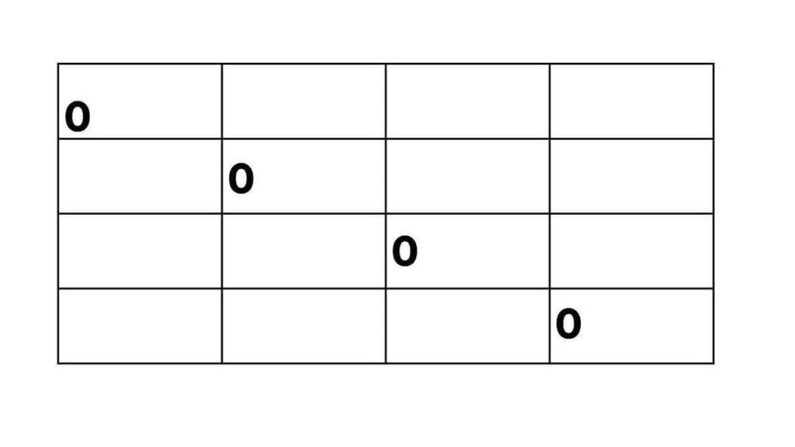
Matrix Chain Multiplication
Step 1: Create the table We create a 4×4 table to store the minimum number of scalar multiplications needed for each subchain. The table initially looks like this:
Step 2: Fill in the table We iterate diagonally through the table, calculating the minimum number of scalar multiplications for each subchain.
First, we consider subchains of length 2: For the subchain AB, the only option is multiplying matrices A and B, resulting in 10 x 5 scalar multiplications. For the subchain BC, the only option is multiplying matrices B and C, resulting in 30 x 5 scalar multiplications. For the subchain CD, the only option is multiplying matrices C and D, resulting in 5 x 8 scalar multiplications.
Updating the table:

Slide 54
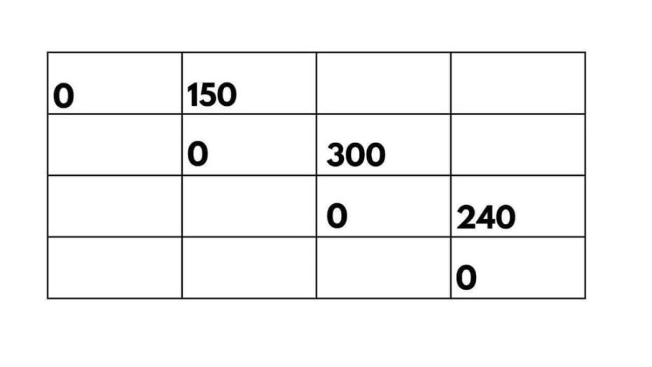
Matrix Chain Multiplication
Next, we consider subchains of length 3: For the subchain ABC, we have two options: (AB)C or A(BC). Let’s calculate the scalar multiplications for each option:
(AB)C: We multiply matrices A and B (10 x 30) resulting in a temporary matrix of size 10 x 5. Then, we multiply this temporary matrix with matrix C (10 x 5) resulting in a final matrix of size 10 x 60. The total scalar multiplications for this option are 10 x 30 x 5 + 10 x 5 x 60 = 4500.
A(BC): We multiply matrices B and C (30 x 5) resulting in a temporary matrix of size 30 x 60. Then, we multiply matrix A (10 x 30) with this temporary matrix, resulting in a final matrix of size 10 x 60. The total scalar multiplications for this option are 10 x 30 x 60 + 10 x 5 x 60 = 9000.
Updating the table

Slide 55
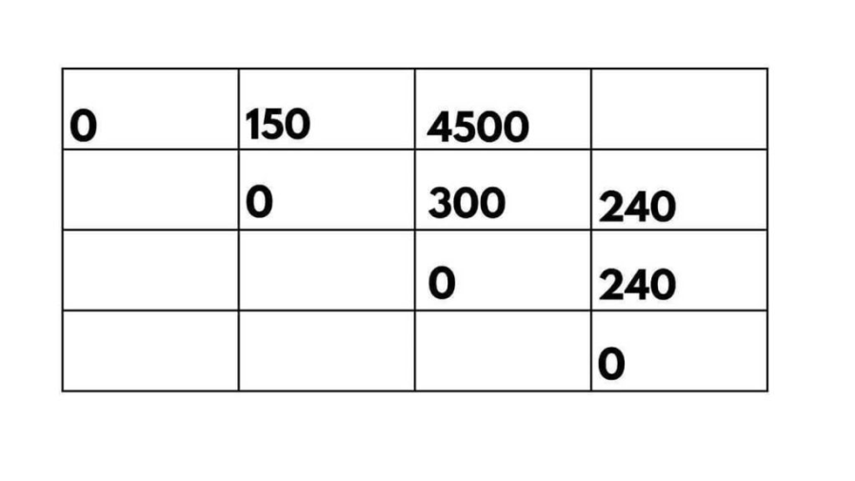
Matrix Chain Multiplication
Finally, we consider the entire chain of matrices ABCD: We have two options: ((AB)C)D or (A(BC))D. Calculating the scalar multiplications for each option:
((AB)C)D: We multiply matrices (AB) and C, resulting in a temporary matrix of size 10 x 60. Then, we multiply this temporary matrix with matrix D (10 x 60), resulting in a final matrix of size 10 x 8. The total scalar multiplications for this option are 10 x 5 x 60 + 10 x 60 x 8 = 6000.
(A(BC))D: We multiply matrices A and (BC), resulting in a temporary matrix of size 10 x 60. Then, we multiply this temporary matrix with matrix D (10 x 60), resulting in a final matrix of size 10 x 8. The total scalar multiplications for this option is 10 x 30 x 5 + 10 x 5 x 8 = 1300.
Updating the table:

Slide 56
Matrix Chain Multiplication
Pseudocode
MATRIX-CHAIN-MULTIPLICATION(p)
n = p.length ─ 1
let m[1…n, 1…n] and s[1…n ─ 1, 2…n] be new matrices
for i = 1 to n
m[i, i] = 0
for diff= 1 to n-1
for i = 1 to n - diff
j = i + diff
m[i, j] = ∞
for k = i to j - 1
q = m[i, k] + m[k + 1, j] + pi-1pkpj
if q < m[i, j]
m[i, j] = q
s[i,j] = k

Slide 57
Matrix Chain Multiplication
Pseudocode to print the optimal output parenthesization −
PRINT-OPTIMAL-OUTPUT(s, i, j )
if i == j
print “A”I
else
print “(” PRINT-OPTIMAL-OUTPUT(s, i, s[i, j])
PRINT-OPTIMAL-OUTPUT(s, s[i, j] + 1, j) print “)”

Slide 58
Longest Common Subsequence (LCS)
Topic link:
4.9 Longest Common Subsequence (LCS) - Recursion and Dynamic Programming – YouTube

Slide 59
Longest Common Subsequence (LCS)
Daily Quiz
Number of unique subproblems in MCM for n matrices:
  A. O(n)
  B. O(n²)
  C. O(n³)
  D. O(2ⁿ)
Matrix Chain Multiplication for 4 matrices uses DP because:
A. Subproblems repeat
B. Greedy gives optimal
C. It's a sorting problem
D. No optimal substructure
Matrix Chain Multiplication is solved using which technique?
    Greedy Algorithm
    Divide and Conquer
    Dynamic Programming
    Backtracking

Slide 60
Longest Common Subsequence (LCS)
Daily Quiz
What does dp[i][j] represent in MCM?
A. Minimum cost to multiply matrices from i to j
B. Maximum cost to multiply matrices from i to j
C. Number of matrices from i to j
D. Dimensions of matrix I
For matrices A(10×20), B(20×30), C(30×40). Minimum multiplications for (AB)C is:
A. 18000
B. 24000
C. 32000
D. 6000

Slide 61
Resource Allocation Problem
(Assembly Line Scheduling)
In resource allocation problems, dynamic programming helps determine the optimal distribution of limited resources among competing entities. Whether it’s allocating bandwidth in a network, assigning tasks to processors, or optimizing production schedules, dynamic programming techniques enable efficient resource allocation.
Which station are chosen from line 1 or line 2 so that we can minimize the time for finished product through the factory.

Slide 62
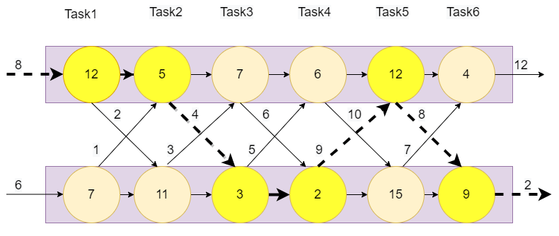
Resource Allocation Problem

Slide 63
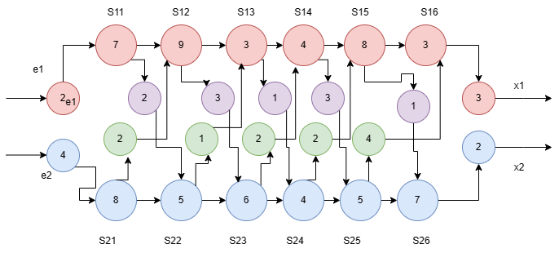
Resource Allocation Problem
 | 1 | 2 | 3 | 4 | 5 | 6
1 | 9 | 18 | 20 | 24 | 32 | 35
2 | 12 | 16 | 22 | 25 | 30 | 37
 | 1 | 2 | 3 | 4 | 5 | 6
1 | 1 | 1 | 2 | 1 | 1 | 1
2 | 2 | 1 | 2 | 1 | 2 | 2

Slide 64
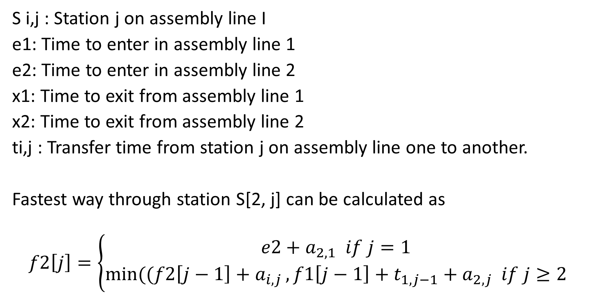
Resource Allocation Problem
S i,j : Station j on assembly line I
e1: Time to enter in assembly line 1
e2: Time to enter in assembly line 2
x1: Time to exit from assembly line 1
x2: Time to exit from assembly line 2
ti,j : Transfer time from station j on assembly line one to another.
Fastest way through station S[2, j] can be calculated as
$$f2\left[j\right]=\left\{\begin{aligned}e2+a_{2,1} if j=1 \\ \min{((f2\left[j−1\right]+a_{i,j}}, f1\left[j−1\right]+t_{1,j−1}+a_{2,j} if j≥2\end{aligned}\right.$$

Slide 65
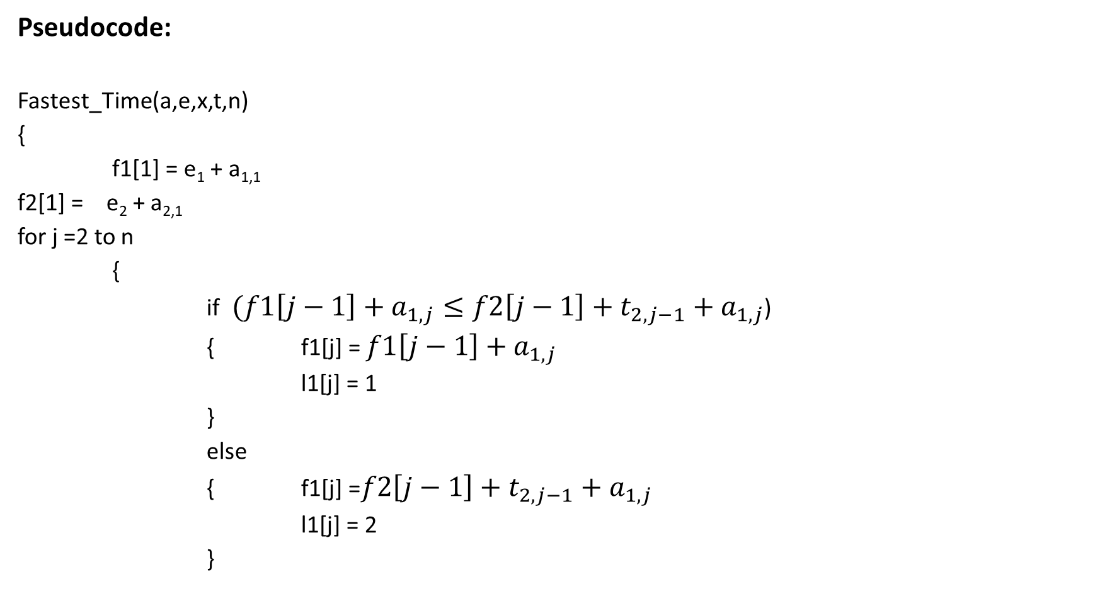
Resource Allocation Problem
Pseudocode:
Fastest_Time(a,e,x,t,n)
{
f1[1] = e₁ + a_{1,1}
f2[1] = e₂ + a_{2,1}
for j =2 to n
{
if ${(f1\left[j−1\right]+a_{1,j}}≤f2\left[j−1\right]+t_{2,j−1}+a_{1,j}$)
{ f1[j] = $f1\left[j−1\right]+a_{1,j}$
l1[j] = 1
}
else
{ f1[j] =$f2\left[j−1\right]+t_{2,j−1}+a_{1,j}$
l1[j] = 2
}

Slide 66

Resource Allocation Problem
if ${(f2\left[j−1\right]+a_{2,j}}≤f1\left[j−1\right]+t_{1,j−1}+a_{2,j}$)
{ f2[j] = $f2\left[j−1\right]+a_{2,j}$
l2[j] = 2
}
else
{ f2[j] =$f1\left[j−1\right]+t_{1,j−1}+a_{2,j}$
l2[j] =
}
}
if f1[n]+x1 $≤$ f2[n] + x2
f’ = f1[n] + x1
l’ = 1
else
f’ = f2[n] + x2
l’ = 2
}

Slide 67
Resource Allocation Problem
Topic Link:
DAA79: Resource Allocation Problem Multistage Graph Solution | Dynamic Programming
Resource Allocation Problem | AKTU DAA

Slide 68
Resource Allocation Problem
Daily Quiz:
Resource Allocation problem is solved using:
A. Greedy Algorithm
B. Divide and Conquer
C. Dynamic Programming
D. Backtracking
2. In dp[i][j], what does j represent?
A. Number of projects
B. Total resources available
C. Profit
D. Index of resource
What is the base case for Resource Allocation?
A. dp[0][j] = 0 for all j
B. dp[i][0] = 0 for all I
C. Both A and B
D. dp[0][0] = 1

Slide 69
Resource Allocation Problem
Daily Quiz:
Time complexity of standard Resource Allocation DP:
A. O(M × N)
B. O(M × N²)
C. O(N³)
D. O(2^N)
If profit[i][k] is not given, we cannot solve Resource Allocation because:
A. We don't know optimal substructure
B. We don't know profit for k resources to project I
C. DP table will be empty
D. Problem becomes NP-Complete

Slide 70
Refrences
Thomas H. Coreman, Charles E. Leiserson and Ronald L. Rivest, “Introduction to Algorithms”, Printice Hall of India.
E. Horowitz & S Sahni, "Fundamentals of Computer Algorithms",
Aho, Hopcraft, Ullman, “The Design and Analysis of Computer Algorithms” Pearson Education, 2008.
LEE “Design & Analysis of Algorithms(POD)”, McGraw Hill
Richard E.Neopolitan ‘Foundations of Algorithms” Jones & Bartlett Learning.
Gilles Brassard and Paul Bratley, Algorithmics: Theory and Practice, Prentice Hall, 1995.

Slide 71
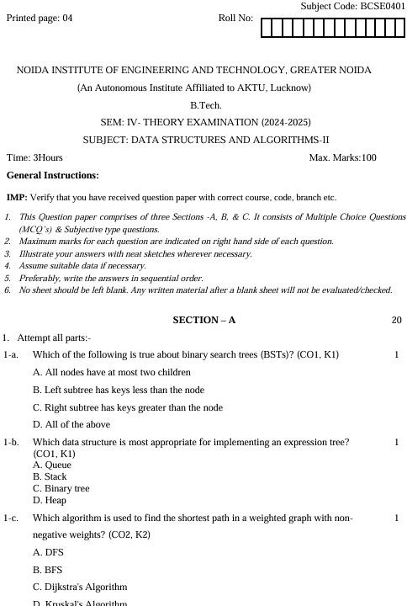
Previous year question paper

Slide 72
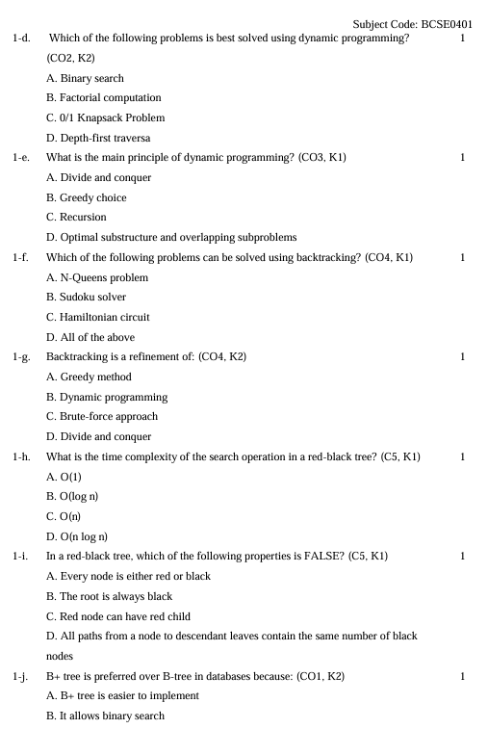
Previous year question paper

Slide 73
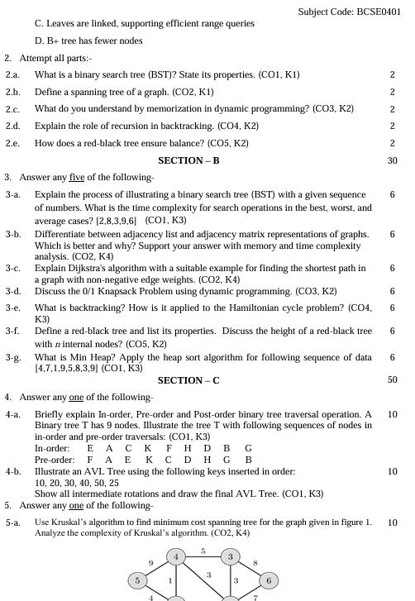
Previous year question paper

Slide 74
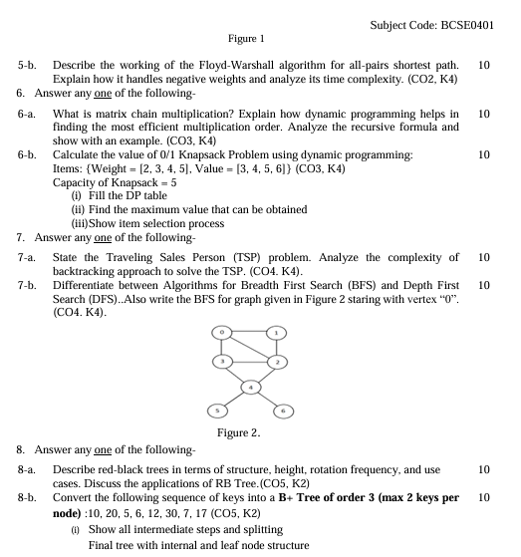
Previous year question paper

Slide 75
Expected Questions for University Exam
Find LCS of "STONE" and "LONGEST". Show DP table and backtrack one LCS.
Find min multiplications for A(5×4), B(4×6), C(6×2), D(2×7). Show k values.
Modify LCS code to print all longest common subsequences for "AGGTAB" and "GXTXAYB".
If a problem can be solved by DP, it can always be solved by greedy." Justify.
3 projects, 5 resources. Profit table: P = 0,2,4,6,7,8; P = 0,1,3,5,6,7; P = 0,3,5,6,7,9. Find max profit.

Slide 76
Previous year question paper
6. W = 8, Items: (wt,val) = (2,3), (3,4), (4,5), (5,6). Fill DP table and find max value.
7. Find min multiplications for A(5×4), B(4×6), C(6×2), D(2×7). Show k values.

Slide 77
Thank You

